Slide 1


Prescription Drugs Analysis
Geraden Hraba, Jacob Cook, Jamila Madda, Kanak Gupta
The Incredibles

Slide 2
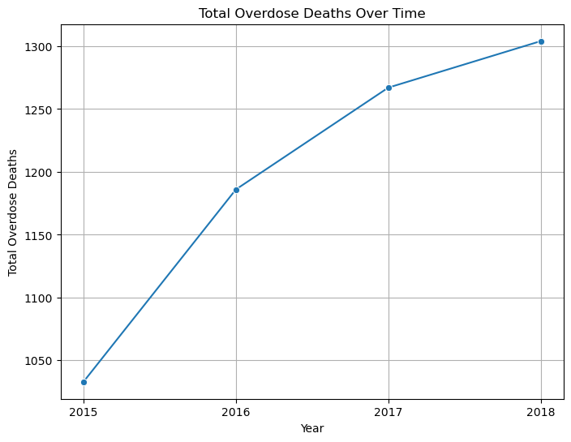
Total Overdose Deaths Over Time
Notes:
The line graph shows the total number of overdose deaths from 2015 through 2018. In 2015, there were just over 1000 overdose deaths statewide. by 2018, the total rises to 1,300.
Overall, this represents roughly a 25% increase in overdose deaths over the four-year period.

Slide 3
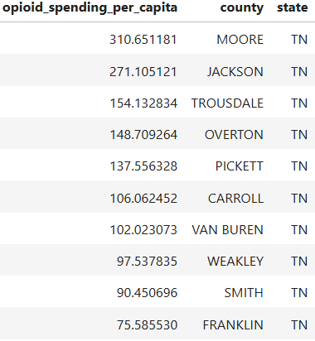
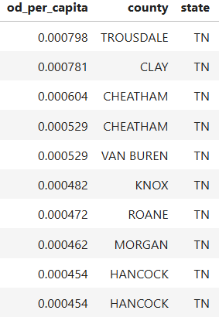
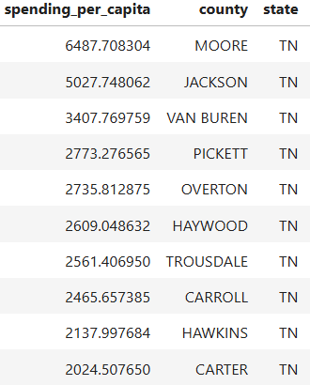
Per Capita
Trousdale County has the highest overdose deaths per capita.
Moore County has the highest spending per capita.
Moore County has the highest spending on opioids per capita.
Notes:
When examined on a per-capita basis, Trousdale shows the highest overdose death rate in the state, followed by Clay and Cheatham—smaller counties where even a handful of deaths translate into a large proportional impact. Meanwhile, Moore County leads in both total prescription spending per capita and opioid-specific spending, with Jackson and Van Buren also ranking high despite their small populations. This contrast highlights an important pattern: high prescribing or spending does not automatically translate to high overdose mortality.

Slide 4
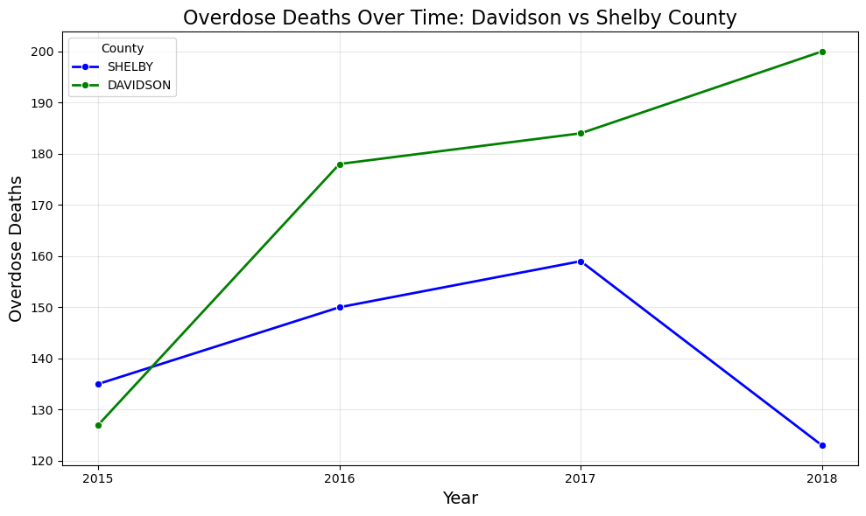
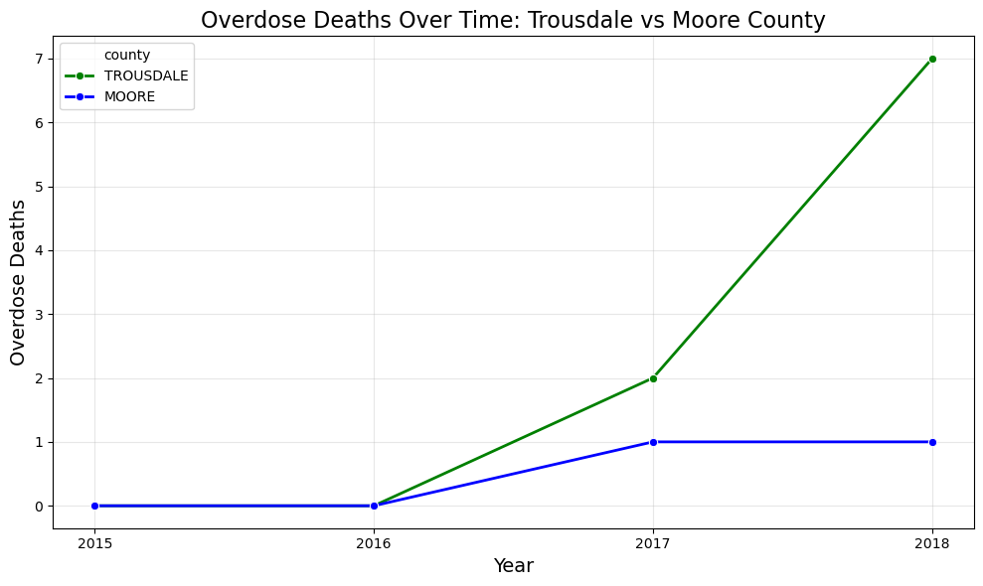
Comparison of County Deaths
Notes:
This theme becomes even clearer when these findings are tied to broader overdose trends across Tennessee. Data comparison shows that overdose trends can diverge sharply even among counties that appear similar on the surface. In Davidson and Shelby comparison, two large urban counties start at comparable levels, but Davidson experiences a continuous and accelerating rise in overdose deaths, while Shelby’s trend reverses with a significant drop in the final year—suggesting differences in community risk factors or intervention success.
A similar pattern emerges in the Trousdale–Moore comparison. Although Moore has the highest per-capita drug and opioid spending, its overdose deaths remain almost flat. Trousdale, despite lower spending, shows a dramatic increase beginning in 2017. This reinforces that high prescription spending alone does not predict overdose mortality.

Slide 5
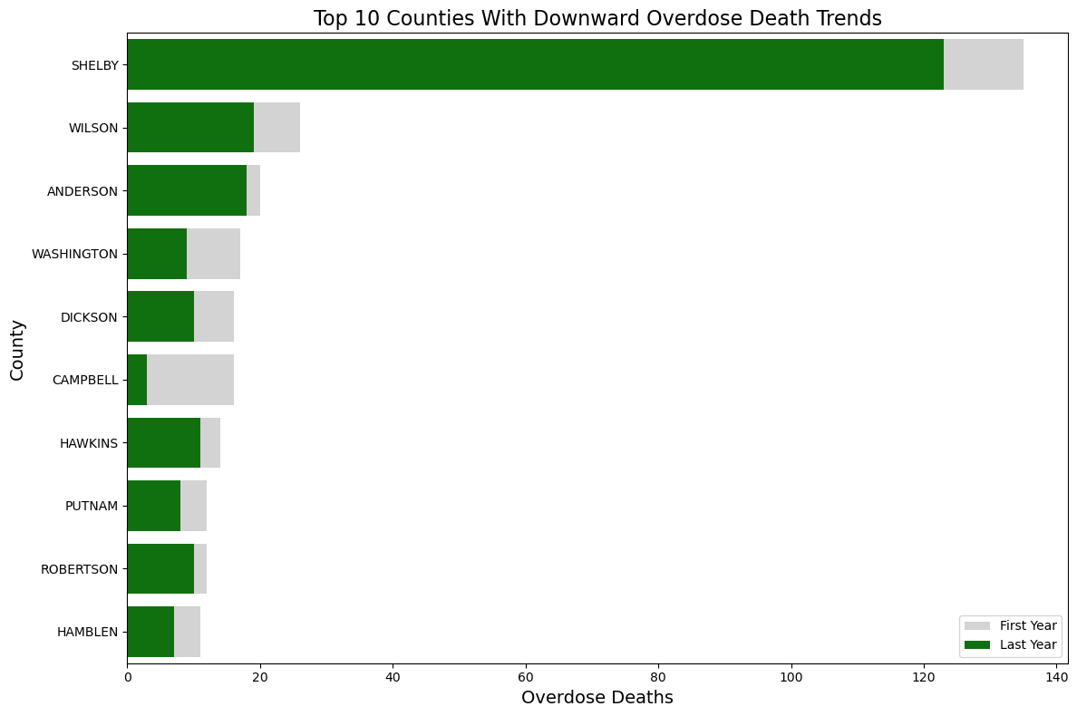
Downward Trending Counties
Notes:
These patterns are mirrored in the list of top counties that successfully reduced overdose deaths during the study period. Shelby County stands out most prominently: even though it started with the highest number of deaths among all downward-trending counties, it still achieved a reduction of more than 20 deaths by the final year. Several smaller counties—such as Wilson and Anderson—also show meaningful declines, demonstrating that progress is possible across both large and small communities, even when their absolute numbers differ.
Overall, the combined findings highlight a central insight: overdose mortality is influenced by a complex interplay of factors—population vulnerability, access to care, local prescribing culture, socioeconomic conditions, and community-level resilience. As a result, county-level trends in Tennessee vary widely, and high-level metrics like prescription spending or population size alone cannot explain overdose outcomes. Understanding these nuances is essential for designing targeted, effective public health interventions.

Slide 6
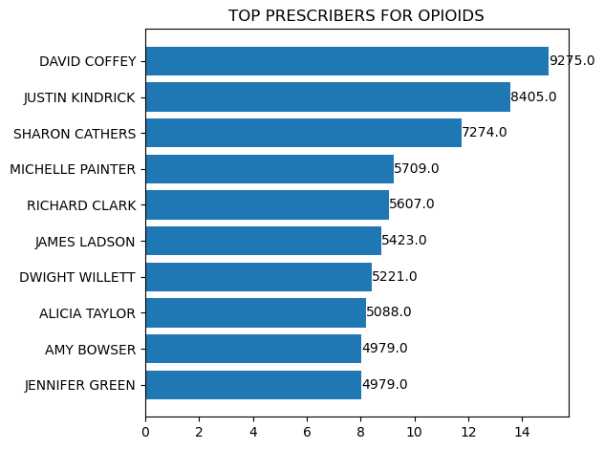
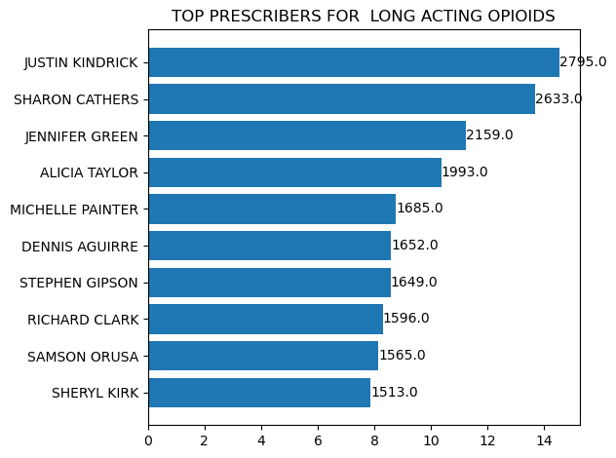
Top Prescribers - DAVID COFFEY
JUSTIN KINDRICK
Notes:
Here we have plotted bar graphs to show top 10 prescribers for opioids and long acting opioids. For the top ten opioid prescriber locations,we see a pattern here. Nearly 90% of top 10 prescribers are from east tn.We all by now know the infamous david coffey from scott county who was convicted for prescribing nearly 5m opioid pills for a period of 8 years.merging the 2 dataframes together we get 7 common prescribers who appear in the top 10 list for both opioids and long acting opioids.intresting find is alicia taylor who ranks 4th in total claim count was also convicted of prescribing opioids outside professional practise without any medical purpose

Slide 7
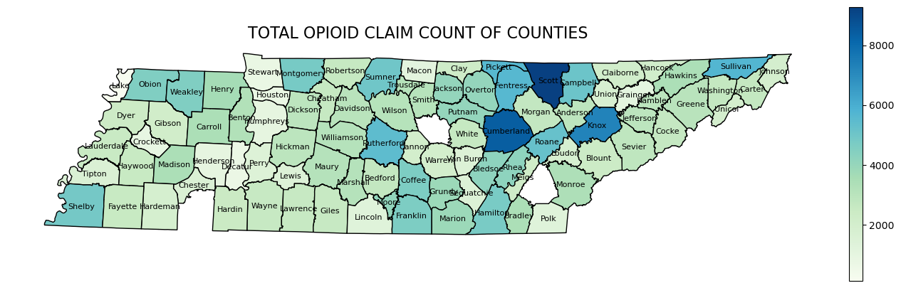
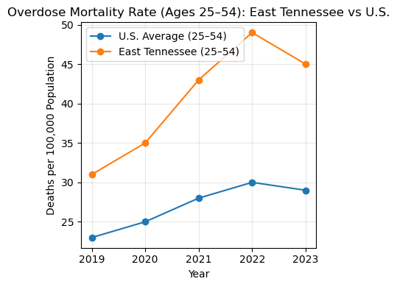
OPIOID CRISIS IN APPALACHIAN EAST TN (Scott,Cumberland,Knox,Sullivan)
EAST TN-
East Tennessee has the highest opioid consumption and comparatively higher number of overdose deaths within TN.
In 2022, 43% of all drug overdose deaths in Tennessee occurred in East Tennessee.
Overdose mortality rate for prime working-age individuals (ages 25-54) was 64% higher than the rest of the U.S. in 2022.
source-Tn dept of health
Notes:
The opioid epidemic is particularly severe in eastern tn due to an intersection of socioeconomic, and healthcare-related factors. There are high rates of unemployment, poverty, and a general lack of economic opportunity, which fosters a "lack of hope" and makes individuals more vulnerable to substance abuse as a coping mechanism or as a way to generate income through the illicit drug economy. Drug manufacturers, most notably Purdue Pharma, targeted Appalachia with aggressive marketing campaigns for OxyContin, downplaying its addictive potential and pushing for its use. Sales representatives were deployed to the region in high numbers and thus. The region became an epicenter for "pill mills" that overprescribed opioids for cash.

Slide 8
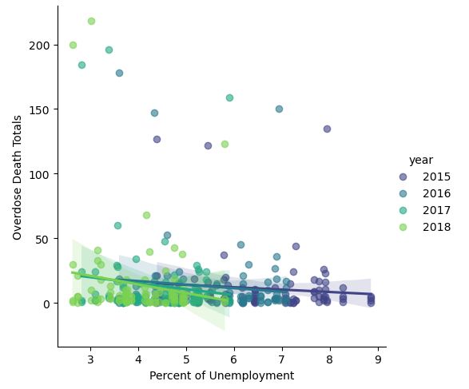
Unemployment Rate vs Overdose Deaths
A. Is there a correlation between unemployment rate and overdose deaths?
B. Is there a correlation between unemployment and spending on opioids?
Notes:
Question 4 Answers Part A- There is some correlation between having less unemployment percentage and higher overdoses and when unemployment creeps higher, overdoses trend lower. This could be for many reasons but if you are unemployed you typically don't have health insurance, which means you are not going to the doctor often or seeking medication. The other side of the correlation is that while unemployment is low and health insurance is abundant, people seek the doctor and medication while it is affordable.
Part B- The data does not provide us with details on when the opioids were dispersed. So while we can get total costs for each opioid, we do not have dates on when they were prescribed to individuals and therefore cannot correlate timelines of unemployment % either daily, monthly or yearly, to opioid costs at the same timeframes.

Slide 9
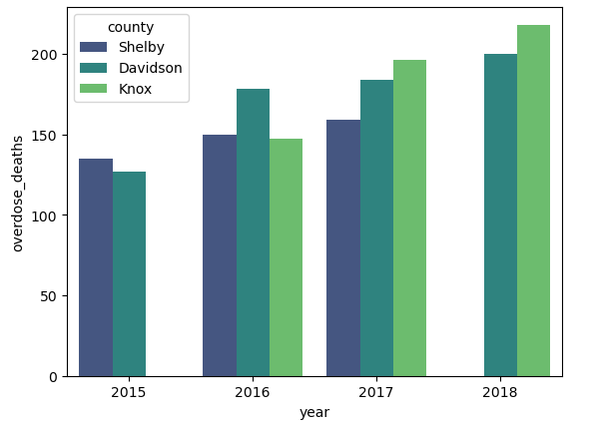
Top 10 Overdose Counties
Highest Overdose Deaths- Knoxville 2018
683 deaths/ 3% unemployment rate.
19 counties over a 4 year span notched a year or more with no overdose deaths. Unemployment for these was at 5.3%.
Lake County is the only county with 4 straight years of 0 overdose deaths. Unemployment went down year to year from 7.18% in 2015 to 4.6% in 2018.
Notes:
Only 3 counties make up our top 10 due to how large they are in population, but you can see that Knoxville was not on the list in 2015 while Shelby was and as we move to 2018, Shelby takes a downturn while Knoxville keeps rising and has the most overdose deaths in that 4 year span. In these 4 years as well, 19 counties notched a year or more with 0 overdose deaths and Lake County seems to be doing something right as they had none reported for 4 straight years even while their unemployment went down during that time.

Slide 10
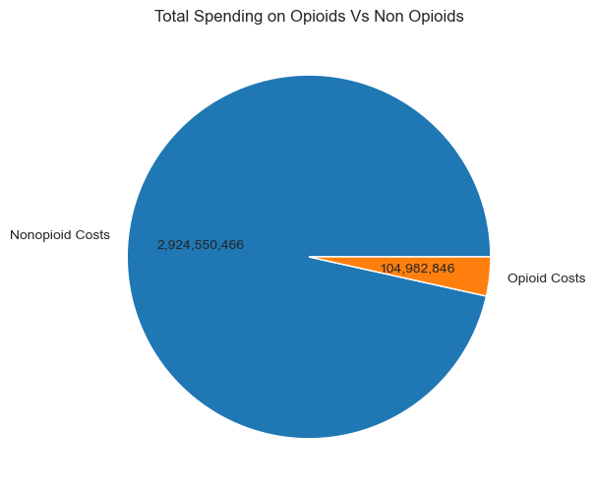
Spending on Opioids and Non Opioids
Out of 1769 different data points only 52 were listed as Opioids
Oxycontin is the most expensive opioid drug with data collected at $19,913,723
Lyrica is the most expensive Non Opioid with a total cost of $78,559,204
Notes:
Opioids take up only 3.5% of the total spending on drugs. And non opioids take up 96.5%. There is a clear line of distinction here but as we’ve seen prior, a lot of the opioid drugs seem to be prescribed in excess for certain areas which caused a lot of death. This 3.5% in a 4 year span led to 4,790 deaths in total.

Slide 11
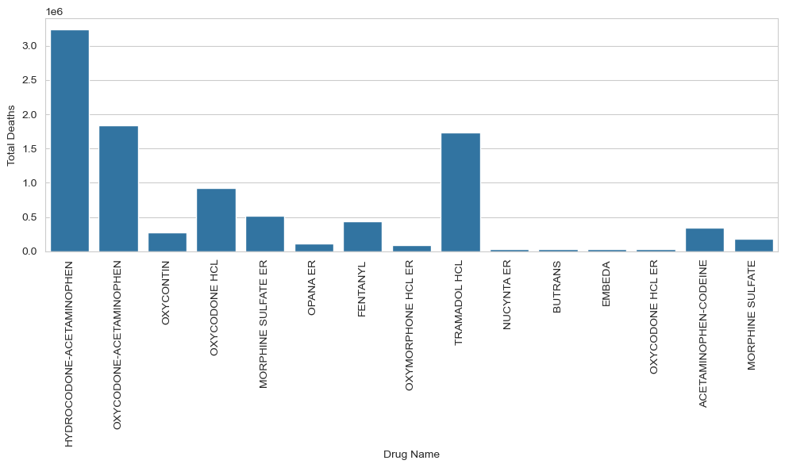
Death Factoids of Opioid Drugs
Hydrocodone has the highest death count
Where as Nucynta has the lowest amount of deaths
Morphine Sulfate is the cheapest in the top 15 priced here
Notes:
And lastly, we have some factoids for some opioids. Hydrocodone has the highest death count. Nucynta has the lowest amount of deaths. And Morphine Sulfate is the cheapest of the top 15 here. Thank you all and hope you enjoyed our presentation. Do we have any questions?

